Slide 1

Ash ranch special use permit
WSUP19-0027
Board of adjustment
July 24, 2020

Slide 2
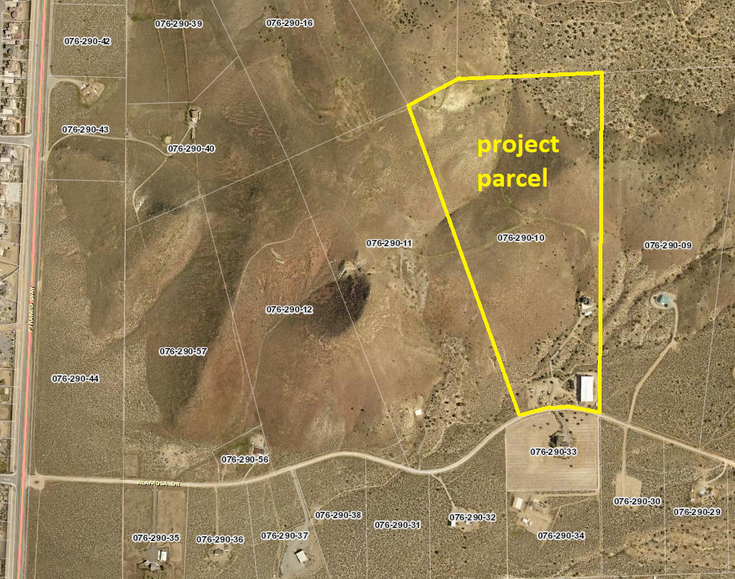
location
430 Alamosa Drive
-about 4 miles north of La Posada
68-acre parcel
Site, and surrounding area, are zoned General Rural (GR)

Slide 3
Purpose of SUP
Establish commercial stable for a maximum of 10 horses
Bring site grading into conformance

Slide 4
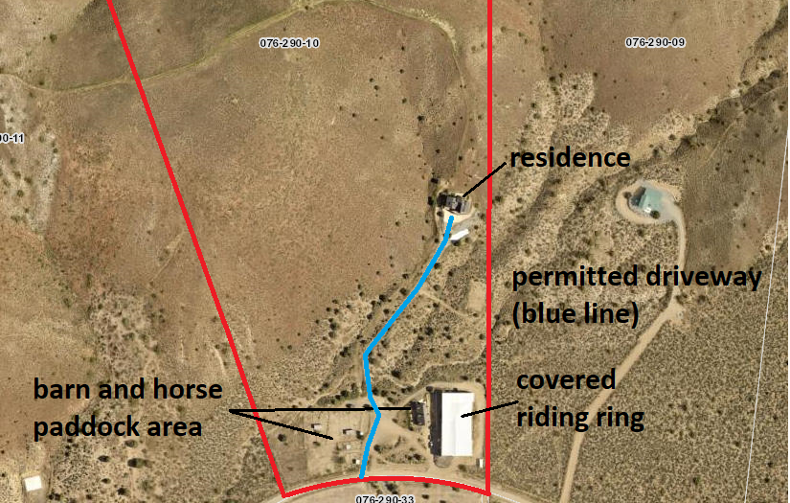
Commercial stable
Limited to 10 horses
No rodeos, commercial riding events, parties, etc.
Horses are primarily “retired”
Children groups will visit for horse care, trail rides
Barn, paddock, fencing, parking already in place
Site is suitable as emergency animal shelter (i.e. during wildfire)

Slide 5
Site plan
Commercial stable occupies only portion of site
Northern half of property is excluded from commercial activity

Slide 6
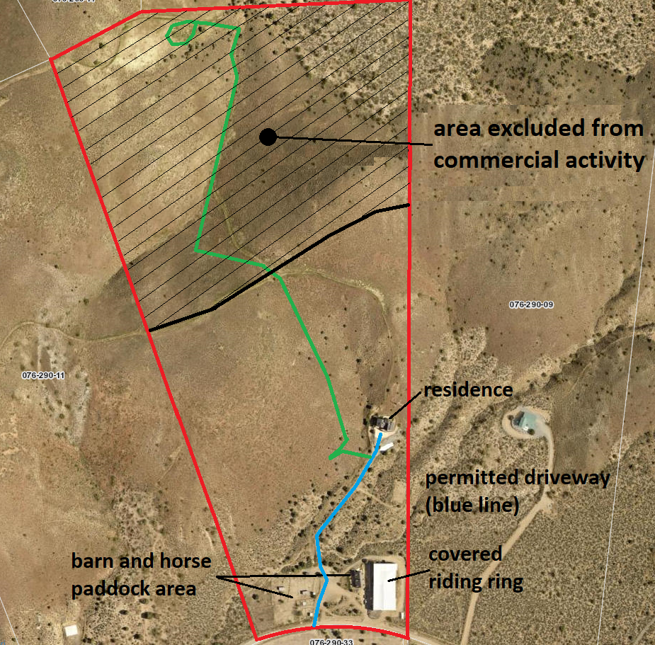
No commercial activity on northern half of site
SUP establishes exclusion area

Slide 7
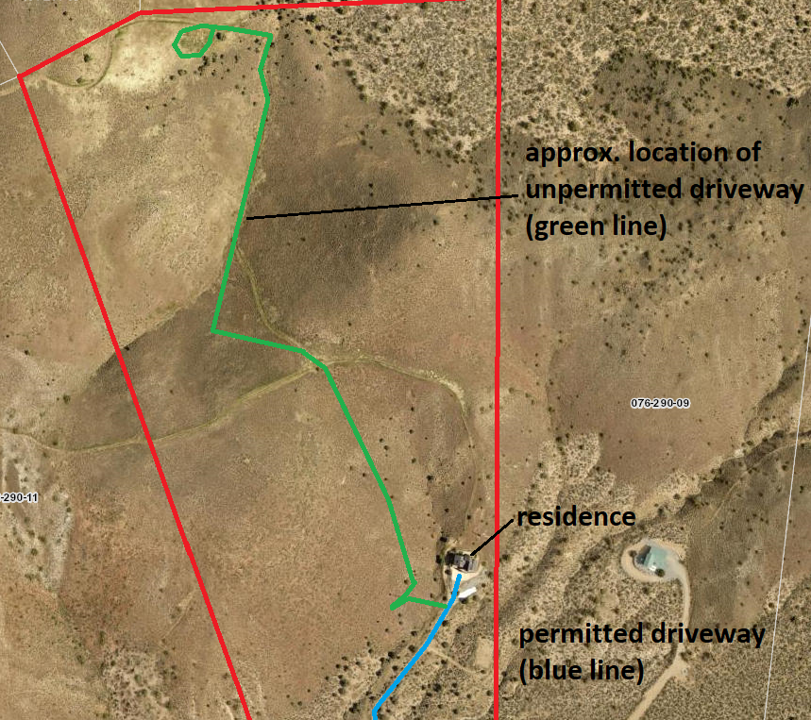
Existing conditions
A driveway was graded several years ago by a previous owner.
The current owner, not realizing this driveway was unpermitted, expanded and improved some of the grading.
This owner is now seeking to rectify this grading through the SUP process and by:
-downgrading the ‘driveway’ to a ‘trail’ (preventing vehicle access)
-remediating some of the grading
-limiting trail width

Slide 8
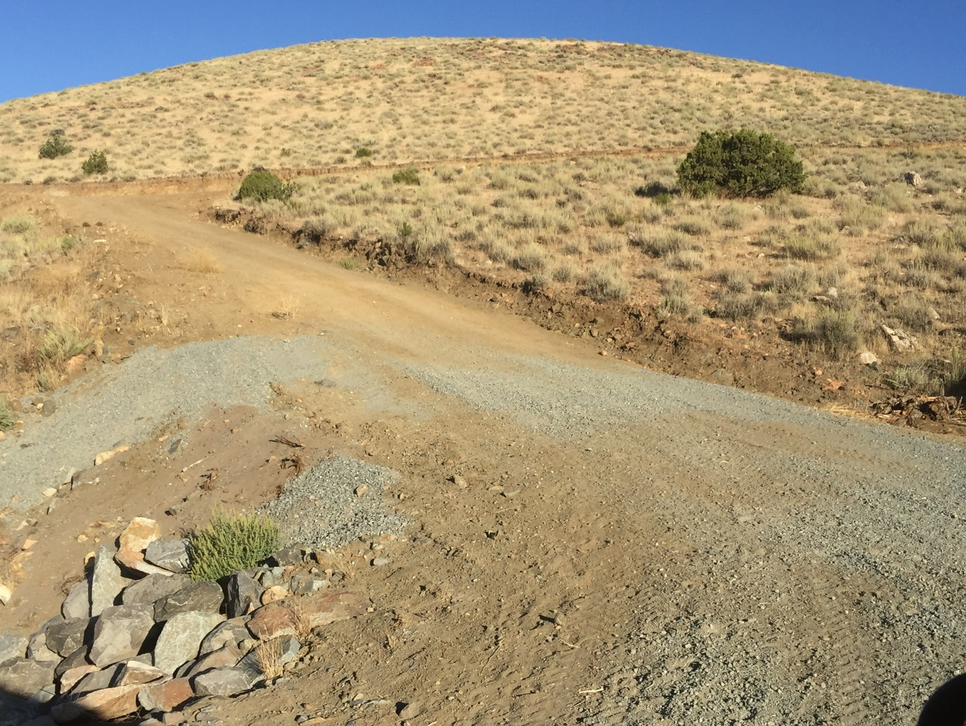
Existing conditions
Photo shows portion of trail leading to northern area of parcel
Any areas subject to erosion will be stabilized
Trail will be limited to 12’ width

Slide 9
Site suitability
The property is large and can easily contain the stable.
Traffic and noise generation will be very low.
No new buildings are needed.
Many properties in the area contain similar trails.
SUP would limit size of stable and number of visitors.

Slide 10
Hearings and Public outreach
Citizen Advisory Board Meeting June, 2020
Owner has informed neighbors of project and has obtained letters of support
Board of Adjustment Hearing July 24, 2020

